Slide 1
Naïve bayes classifier
by
Anusha g s

Slide 2
Problem statement
Safe to eat or deadly poison?

Slide 3
Naive Bayes classifier workflow
Step 1: Calculate the prior probability for given class labels.
Step 2: Find Likelihood probability with each attribute for each class.
Step 3: Put these value in Bayes Formula and calculate posterior probability.
Step 4: See which class has a higher probability, given the input belongs to the higher probability class.

Slide 4
Features of the Dataset
8124 datapoints.
22 features:
22 categorical features
One Target Variable : target_class
poisonous – 3916 Count
edible – 4208 Count
Dataset split into Train and Test set for modelling purpose. Train set had 6499 datapoints. Test set had 1625 datapoints.

Slide 5
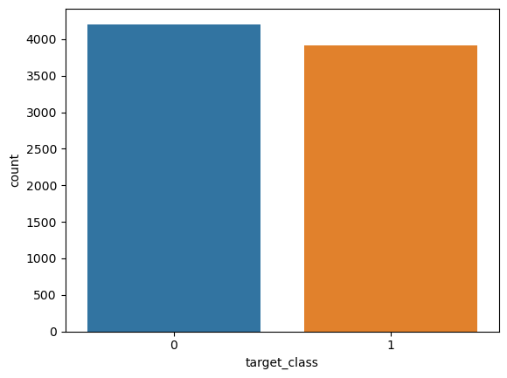
Data visualization

Slide 6
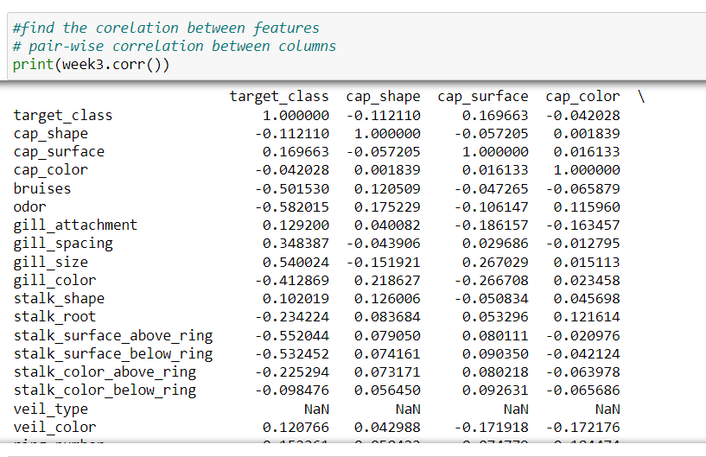
Correlation

Slide 7
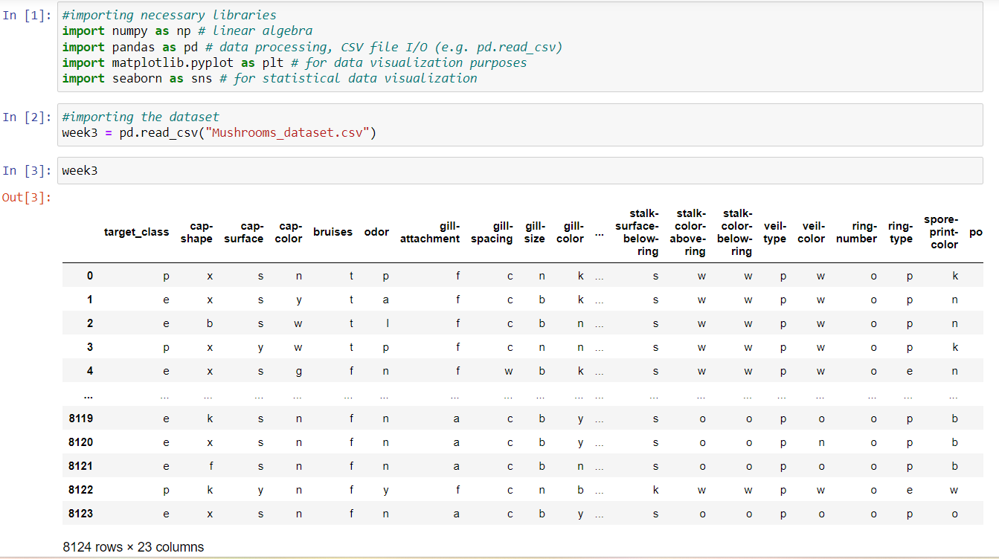
CODING

Slide 8
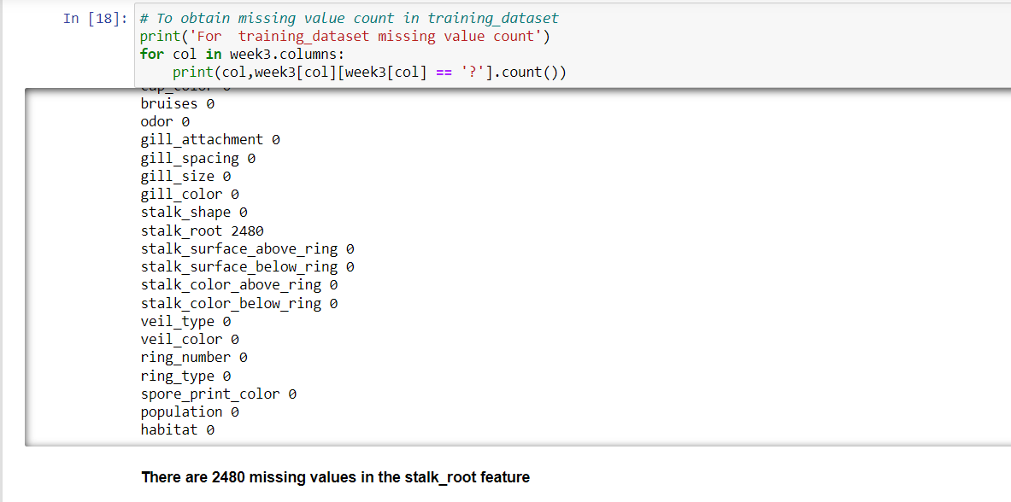
CODING

Slide 9
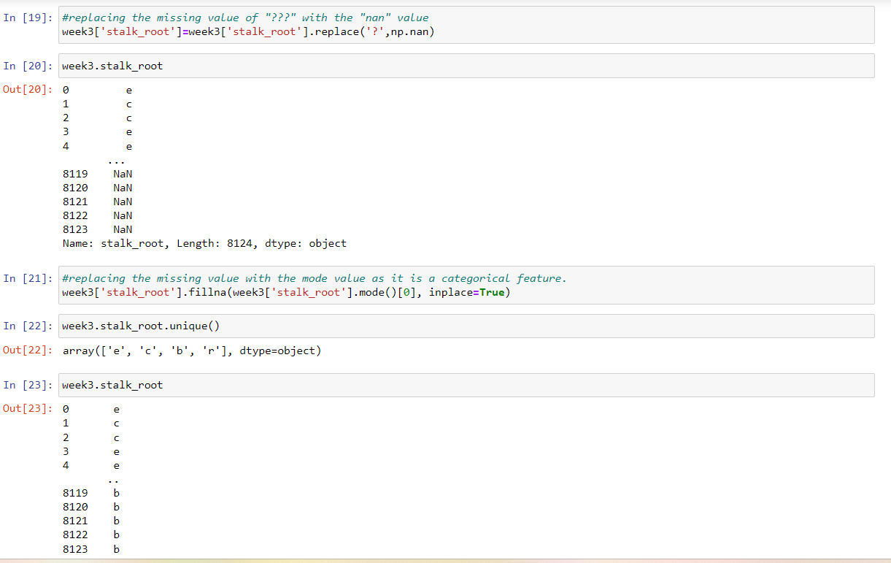
CODING

Slide 10
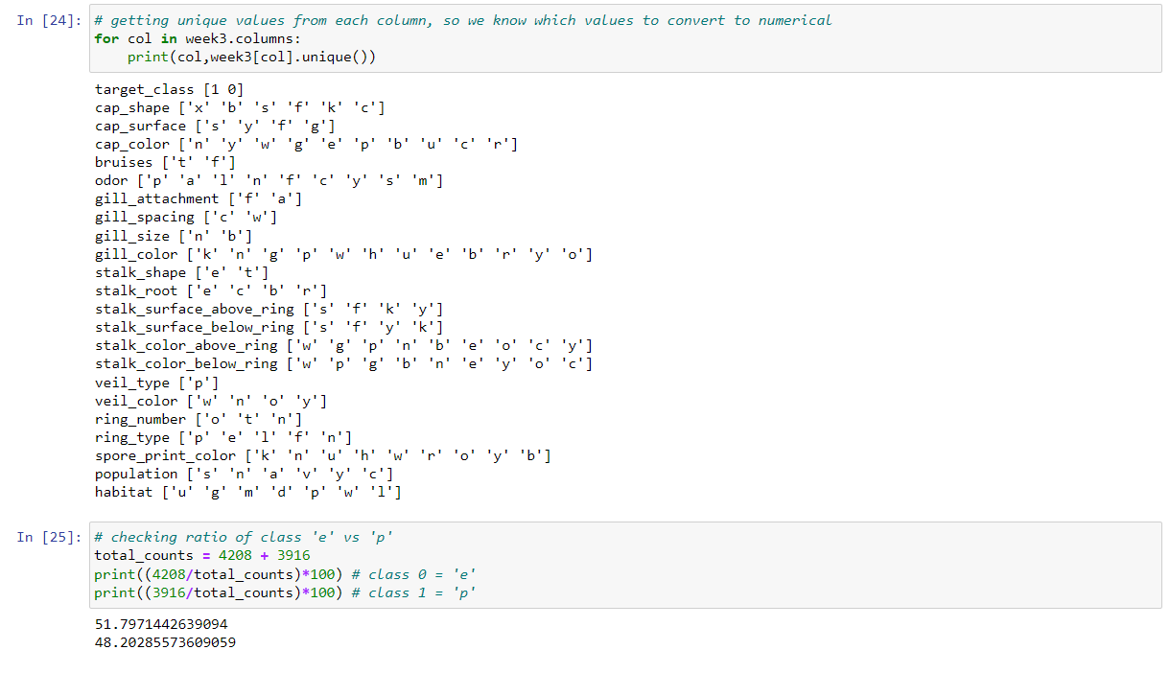
CODING

Slide 11
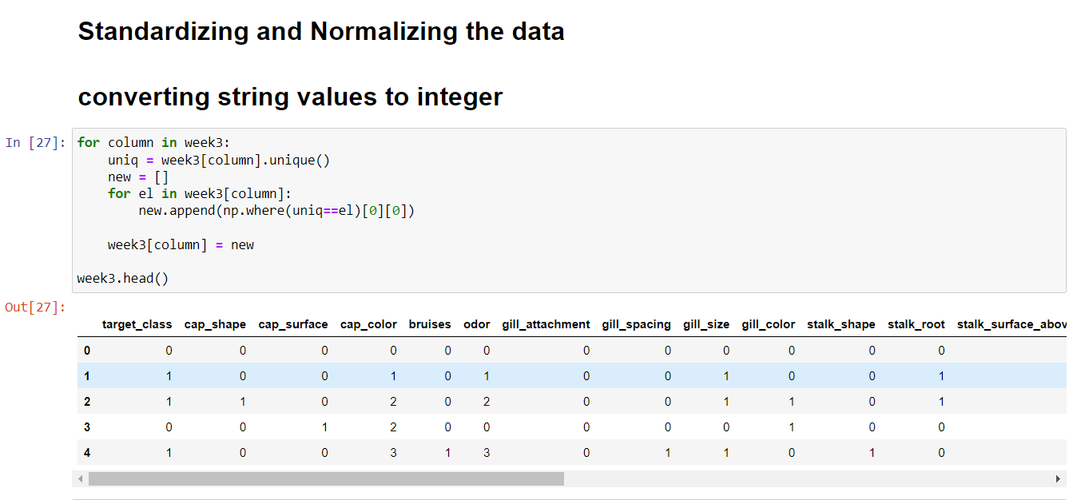
CODING

Slide 12
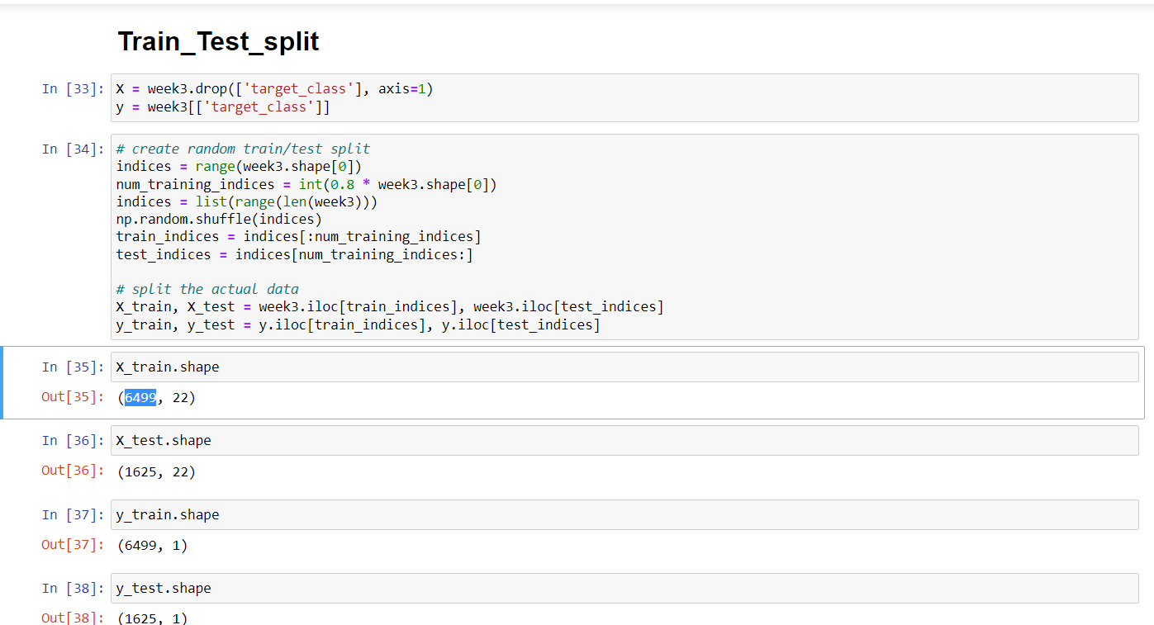
CODING

Slide 13
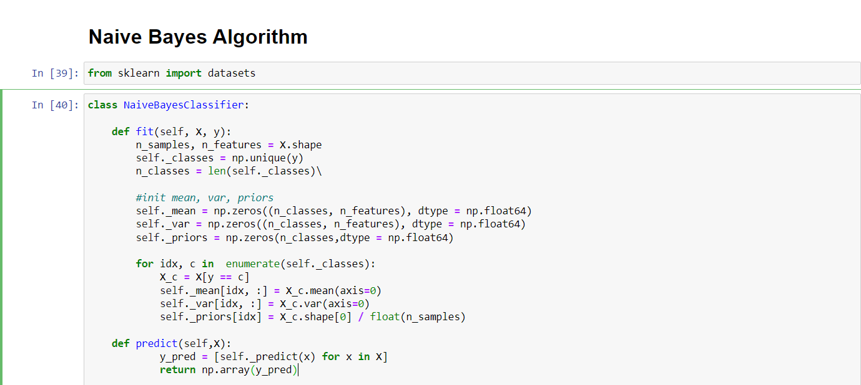
Model coding from scratch

Slide 14
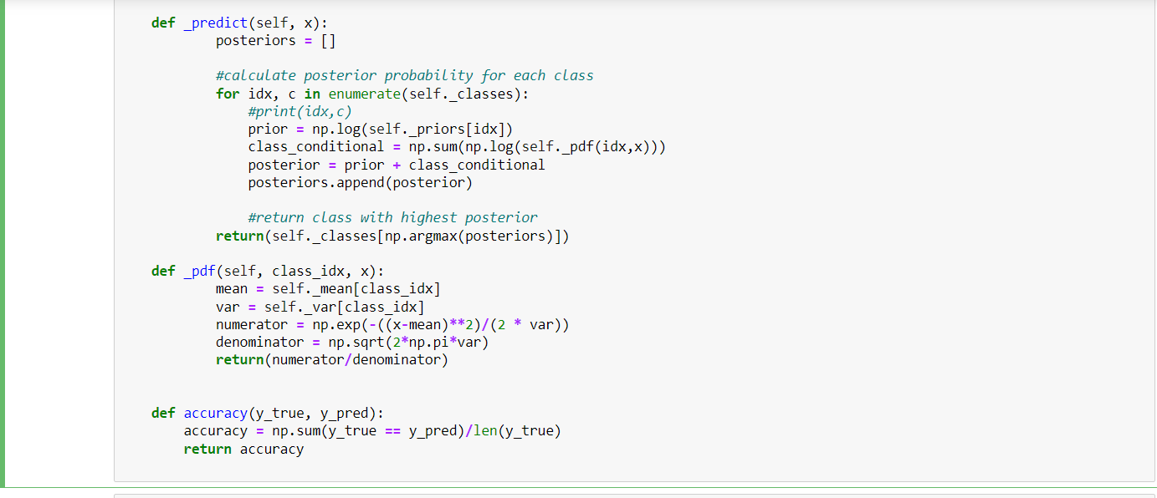
Model coding from scratch

Slide 15
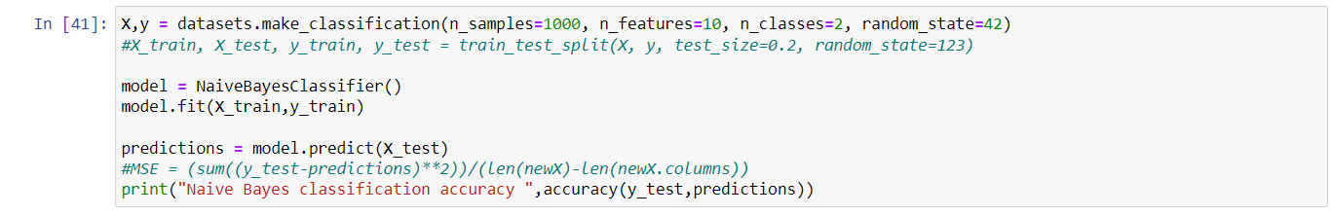
Model coding from scratch

